Slide 1



Exploring Poisson Distribution
Welcome to a journey through the fascinating world of Poisson distribution. We'll explore its history, properties, and applications, and also discuss its limitations and assumptions. Let's get started!

Slide 2
Definition and Characteristics
1
What is Poisson Distribution?
2
Probability Mass Function
A discrete probability distribution that describes the probability of a number of events occurring in a fixed interval of time or space.
Describes the probability of x events occurring in a given interval of time or space.
3
Mean and Variance
4
Skewness and Kurtosis
Mean = λ (lambda), which is the average number of events in the given interval. Variance = λ, which means the variability is equal to the mean.
Skewness measures the asymmetry of the distribution. Kurtosis measures the tailedness and peakness of the distribution.

Slide 3
Applications of Poisson Distribution
Modeling Rare Events
Queueing Theory
Reliability Analysis
Poisson distribution can be used to model the arrival of customers or items in a queueing system.
Poisson distribution can be used to estimate the probability of failure of a device or system.
Poisson distribution is commonly used to model rare events such as accidents, errors, and defects.

Slide 4

Limitations and Assumptions
Independence Assumption
The events under consideration must be independent of each other.
Homogeneous Time Intervals
The interval between events should be fixed and the same for all events.
Low Event Rates
Poisson distribution is not suitable for situations where the event rate is high or the number of events is not rare.

Slide 5

Parameter Estimation and Significance Testing
1
Maximum Likelihood Estimation
A method for estimating the parameters of Poisson distribution from data.
2
Goodness-of-fit Tests
Statistical tests to check whether the observed data matches the expected Poisson distribution.

Slide 6

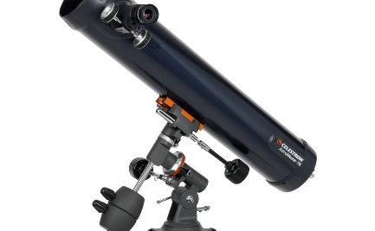

Conclusion and Future Directions
Summary of Key Points
Areas for Further Research
Thank You!
Poisson distribution is a useful tool for modeling rare events, queueing systems, and reliability. It has some limitations and assumptions, and requires parameter estimation and significance testing.
We hope you enjoyed this presentation on Poisson distribution. Stay curious!
Possible research directions include extensions of Poisson distribution to non-integer values, non-stationary processes, and dependence structures.

